Slide 1
Correlation of Stock Market and Sentiment of Discussion on Reddit
Submitted by
Leela Venkata Rama Sai Yeluri (099719246)
Geethika Chennupati (964069268)

Slide 2
Content
Introduction
Project Objectives
Design Overview
Sentiment Analysis
Reddit Wall Street Bets Dataset
GameStop Share Dataset
Sentiment and Share

Slide 3
Introduction
There had been instances where an online discussion group can impact the real world. For example, the reddit group had raised the stock price of the “game stop” by asking community to buy share.
Large hedge fund companies who had taken the short position has bearer the large sum of loss.
Likewise there are studies which shows correlation between the crypto price and the Elon musk’s tweet.
So, with the help of this study, sentiment of the reddit discussion is correlated with stock market movement.

Slide 4
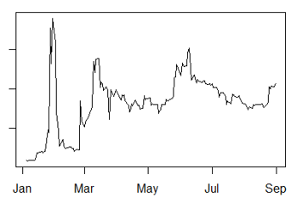
This information can be used to find out the factor which are affecting the stock market abrupt movement.
These abrupt movement are very hard to predict, and many people often must suffer by losing large sum.
Sometimes these abrupt changes are for very short duration.

Slide 5
Project Objectives
Explore NLP tools for R
Perform Literature review
Collect data from reddit
Collect stock market data
Perform NLP on reddit data
Perform correlation analysis
Finding any relationship between the sentiments and market movement

Slide 6
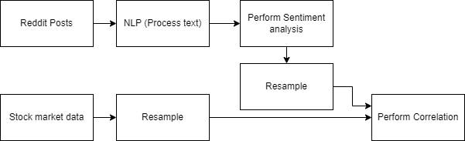
Design Overview

Slide 7
What is Sentiment Analysis?
Sentiment Analysis looks at how a piece of writing express emotion.
It is nothing but analyzing the data and classifying the data into different classes based on the emotion that data has.
These classes can be binary in nature like positive or negative, it can also have multiple classes like human emotion as joy , sad , fear etc.

Slide 8
Why Sentiment Analysis?
Sentiment Analysis is a powerful tooll and it has a wide variety of applications.
It helps Bussiness in identifying information and better understand their customers.
It is applicable in brand monitoring , customer service , social media monitoring and many more .
So, choosing sentiment analysis will help us in better understanding how the organisations run and what they expect from future data scientits.

Slide 9
Sentiment Analysis
Extracts the public opinion
Based on type of word used (lexicon based)
From the movie/Hottel reviews and rating(machine learning based)
“sentimentr” library is used to calculate the sentiment of the reddit post titles -library

Slide 10
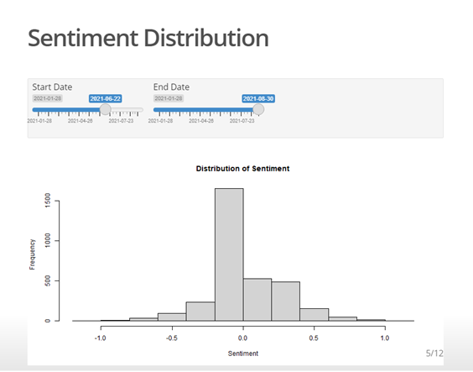
Sentiment Distribution

Slide 11
Sentiment Distribution
Sentiment Polarity are concentrated nearer to zero
Lean toward positive
There is no distinct side in reddit discussion

Slide 12
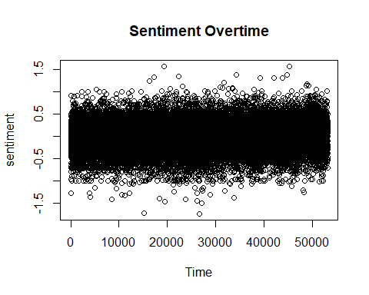
Sentiment Overtime

Slide 13
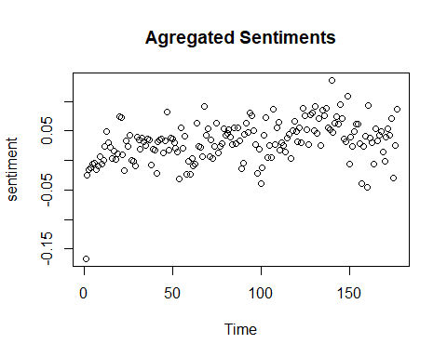
Daily Average Sentiments

Slide 14
Sentiment Overtime and Daily Average
Overall Positive
Stationary pattern in the overtime sentiments
Does not clearly seen correlating with stock price.
Over the time overall positive sentiment increased.

Slide 15
Game Stop
It’s an American electronic Retail Company
Stock is listed in New York Stock Exchange
Market Cap: $12.72B

Slide 16
Short Positioning
Opportunity
Investors thinks that price of the stock may go down.
Open Short Position
Investors borrows stocks at current price
Sells The Stock
Investor sells borrowed stock
Closing Short position
Investors wait until stock price fall, after price falls investors buys those stock again at cheaper cost. And it called holding a short position.

Slide 17
Short Positioning
Revenue
Once buying back the stock, investors gives back the borrowed stock
Since investor had borrowed to stock at price when it was high and sold it market and waited till it’s price had fall. And then investor had bought again at lower price than he had sold.
So let’s suppose investor had sold 10 stock at 10$ each and bought 10 stock at 5$ each then investor earned 5$x10 = 50$

Slide 18
Short Positioning
Shortcoming!
This are usually called future contracts
Instead stock price falling it may go up as well (As in the case of Game Stop)
For example now the stock price is 15$ per stock then investor had lost 5$x10 = 50$ (continuing previous example)
Can cause Short Squeeze!

Slide 19
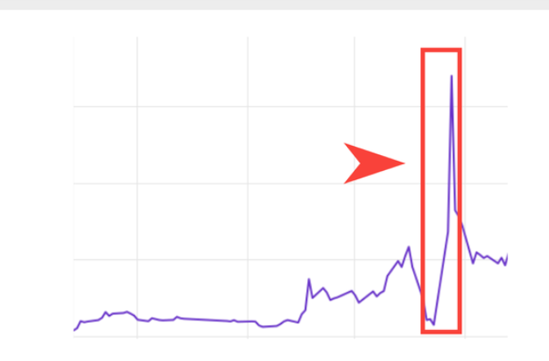
Short Squeeze
When multiple investors had taken Short Position on any company's stock
Instead of falling price, stock price increase!
Investors get panicked and to cover losses, they all immediately tries buy stock price
Causes sudden surge in the demand
Drives the stock price high

Slide 20
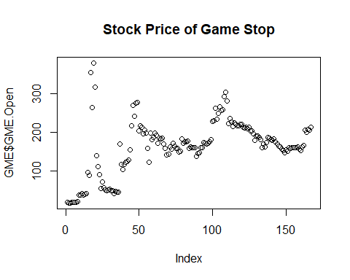
Stock price Overview

Slide 21
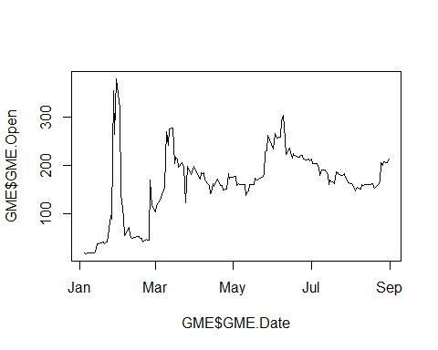
Price and Sentiments

Slide 22
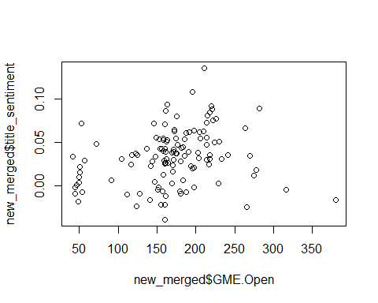
Scatter Plot

Slide 23
## Correlation
## [1] "Correlation:"
## [1] 0.2399713
It has low correlation

Slide 24
Liner Regression
## ## Call: ## lm(formula = GME.Open ~ title_sentiment, data = new_merged) ## ## Residuals: ## Min 1Q Median 3Q Max ## -134.257 -21.606 0.018 27.656 232.049 ## ## Coefficients: ## Estimate Std. Error t value Pr(>|t|) ## (Intercept) 154.817 7.614 20.334 < 2e-16 *** ## title_sentiment 444.479 164.143 2.708 0.00776 ** ## --- ## Signif. codes: 0 '***' 0.001 '**' 0.01 '*' 0.05 '.' 0.1 ' ' 1 ## ## Residual standard error: 57.18 on 120 degrees of freedom ## Multiple R-squared: 0.05759, Adjusted R-squared: 0.04973 ## F-statistic: 7.333 on 1 and 120 DF, p-value: 0.007761

Slide 25
Linear Regression
Based on the P-value of sentiment It is significant features.
0.00776 < 0.05 So here that feature is significant at significance level 5%
There is some relation between Reddit Sentiments and Stock price

Slide 26
Conclusion
Reddit sentiments and Stock price are linearly dependent and there is significant evidence of after using p-test.
So, this answers that, yes, there is some relationship between the Reddit sentiment and the game stop stock price.
We have p-values which we got after doing hypothesis testing to justify the correlation.

Slide 27

Thank you

